Slide 1






Slide 2


The Seven C’s of Effective Communication
To compose effective written or oral messages, you must apply certain communication principles. These principles provide guidelines for choice of content and style of presentation, adapted to the purpose and receiver of your message. Called the “seven C’s,” they are completeness, conciseness, consideration, concreteness, clarity, courtesy, and correctness.
The 7 Cs provide a checklist for making sure that your meetings, emails, conference calls, reports, and presentations are well constructed and clear – so your audience gets your message.

Slide 3

THE SEVEN C’s
Completeness
Conciseness
Consideration
Concreteness
Clarity
Courtesy
Correctness

Slide 4

COMPLETENESS
Business message is said to be complete when it contains all facts the reader or listener needs for the reaction the sender desires.
As you strive for completeness, keep the following guidelines in mind;
Provide all necessary information. Otherwise it will create suspicion.
Answer all questions asked.
Give something extra when desirable.

Slide 5
 Provide All Necessary Information
Answering the five W’s helps make messages clear: Who, What, When, Where, and Why.
 Answer All Questions Asked (W & H, Implies, stated)
Look for questions: some may appear and some are buried within a paragraph.
Locate them and then answer precisely.
Use five W’s method (for requests and announcements etc.)
What, where, when, why, who and even who.
Identify stated and implied questions.
Give Something Extra, When Desirable
Use your good judgment in offering additional material if the sender’s message is incomplete.

Slide 6
If you want your client to book hotel accommodation for you, you should tell him/her what your needs are, where you want it; when you want it and how you are going to pay for it etc.
When you tell your subordinate to go to the airport to receive someone, you should tell him at what time, who the person to be received is and where he should be taken to etc. This is completeness.
Completeness prevents the need for further communication, amending, elaborating and expounding (explaining) the first one and thus saves time and resource.

Slide 7
EXAMPLES
Incomplete:
1. I did not receive any response for the complaint I lodged.
Complete:
I made a complaint to the Branch Manager on June 23, 2003 on the inordinate delay at the cash counter. Can I get a response?
Incomplete;
2. I want a room booked at your hotel for three days in the first week of the month of July.
Complete;
I will be arriving on July 3rd morning by Pandora Express. I want a single room accommodation for three days from 3rd morning. I want a room with attached toilet, running hot water facility and telephone (if available). Kindly do the booking in my name.

Slide 8
Bad example:
Hi all,
Let us meet tomorrow to discuss the product launch event. Please be there on time.
Thanks A.B.C.
(There is no mention of the time of the meeting scheduled for, or the location, neither is there any set agenda. The recipients of the email would have to write back or call back to Chris to clarify).
Good example:
The best way to have written this email is:
Hi all,
Let us meet tomorrow at 11am at Conference room 3 to discuss the product launch event. We will have to decide the keynote speakers and complete the event invite draft tomorrow. Please be there on time.
Thanks A.B.C.

Slide 9
COMPLETENESS: EXERCISE
Use five W,s method to complete the given tasks.
Task 1.
Write an email to the admin officer of the ABC Banquet to reserve it for your brother`s marriage. Keep in mind the requirements of completeness while requesting.
Task 2
Write an email to request/order merchandise (goods) for your ABC mart. (Mention when you need it, how and when it would be transported and to whom it would be delivered and how the payment will be made)

Slide 10
COMPLETENESS
You are the president of an industry association and
have received the following inquiry from an out of town
member, “I think I would like to attend my first meeting
of the association, even though I am not acquainted
with your city. Will you please tell me where the next meeting is being held?
 How would you reply to this letter keeping in mind
Completeness of the message?

Slide 11

CONCISENESS
Conciseness is saying what you want to say in the fewest possible words without sacrificing the other qualities. A concise message is complete without being wordy.
To achieve conciseness, observe the following suggestions;
Eliminate wordy expressions/ avoid Circumlocution.
Include only relevant material.
Avoid unnecessary repetition.

Slide 12

Eliminate Wordy Expressions
 Use single words in place of phrases.
Example
Wordy: At this time Concise: Now Wordy: In due course Concise: Soon
Wordy: Due to the fact that Concise: Because

Slide 13

Include Only Relevant Material
Stick to the purpose of the message.
Delete irrelevant words and rambling/confused sentences.
Omit information obvious to the receiver.
Avoid long introductions , unnecessary explanations, excessive adjectives and prepositions.
Get to the important point tactfully and concisely.

Slide 14

Include Only Relevant Material
Example
Wordy: We hereby wish to let you know that our company is
pleased with the confidence you have shown.
Concise: We appreciate your confidence.
Wordy: At this time I am writing to you to enclose an interview card, which has been post-paid, for the purpose of arranging a convenient time when we might get together for a personal interview.
Concise: Please return the enclosed interview card to set up a
convenient time for an interview.

Slide 15

Avoid Unnecessary Repetition
 Use a shorter name after you have mentioned the long one once. Instead of the “North Central Company,” use “North Central”
Use Pronouns or Initials rather than repeating long names.
Cut out all needless repetition of phrases and sentences.

Slide 16
Task: Find single word substitutes for the phrases
afford an opportunity as a means of at this point in time due to the fact that during the period has a requirement for in a timely manner in accordance with
in advance of
in regard to
in the amount of
in the event that
in the near future
no later than June 1
pertaining to
with reference to
with the exception of

Slide 17
Instead of | Try
afford an opportunity | allow, let
as a means of | to
at this point in time | now
due to the fact that | because
during the period | during
has a requirement for | needs
in a timely manner | quickly, promptly
in accordance with | by, following, per, under
in advance of | before
in regard to | about, concerning, on
in the amount of | for
in the event that | if
in the near future | shortly, soon
no later than June 1 | by June 1
pertaining to | about
with reference to | about
with the exception of | except

Slide 18














Exercise
Find single word substitutes for the phrases
Along the same lines
At this time
Consensus of opinion
Due to the fact that
During the time of the day
During the year of
Few and far between
For a price of

Slide 19


Exercise
 Make the following sentences concise:
Due to the fact that the seat belt broke, the passenger sustained a high degree of injury.
In accordance with the will of the clients, we undertook the steps mentioned in the report.
During the month of April, we will begin to package our product in boxes rectangular in shape and yellow in color.

Slide 20
Make the following sentences concise:
If we plan on showing an improvement of 20 percent, we will need to advance forward in our outlay and productivity.
The students and the faculty cooperated together to devise and develop a totally unique forum for discussion.

Slide 21

CONSIDERATION
Consideration means preparing every message with the message receivers in mind; try to put yourself in their place. You are considerate, you do not lose your temper, you do not accuse and you do not charge them without facts. the thoughtful consideration is also called “you-attitude”.
Focus on “You” instead of “I” and “We”.
Show audience benefit or interest in the receiver.
Emphasize positive and pleasant facts.
Visualize readers` problems, desires, emotions and response.

Slide 22


Focus on “You” Instead of “I” or “We”
 Using “you” does help project a you-attitude. But overuse can lead to a negative reaction.
Example
We-Attitude: I Am delighted to announce that we will be extending our hours to make shopping more convenient.
You-Attitude: You will be able to shop in the evenings with the extended hours.

Slide 23

Show Audience Benefit or Interest in the Receiver
 Reader may react positively when benefits are shown them. Benefits must meet recipients needs, address their concerns, or offer them rewards. Most important they must be perceived as benefits by the receivers.

Slide 24

Exercise
Write with a “you” attitude; it shows consideration.
I want to send my congratulations for ---
We will ship soon the goods of your May 4 order--
We pay eight percent interest on -----

Slide 25

Emphasize positive, pleasant facts.
Negative- Unpleasant | Positive - Pleasant
It is impossible to open an account for you today. | As soon as your signature card reaches us, we will gladly open an account
We do not refund if the returned item is soiled and unsalable. | We refund when the returned item is clean and resalable.
When you travel on company expense, you will not receive approval for first class fare. | When you travel on company expense, your approved fare is for tourist class.

Slide 26

CONCRETENESS
Communicating concretely means being specific, definite, and vivid rather than vague and general. Often it means using denotatives (direct, explicit, dictionary based) rather than connotative words (ideas or notions suggested by or associated with a word or phrase).

Slide 27

CONCRETENESS
The following guidelines should help you compose concrete, convincing message;
Use specific facts and figures.
Put action in your verbs.
Choose vivid, image building words.

Slide 28
Use Specific Facts and Figures
 It is desirable to be precise and concrete in both written and oral business communication. Avoid vagueness. Commercialese (Business Jargon), cliché now.
Vague, General, Indefinite Students’ GMAT scores have risen.
Concrete, Precise
In 1996, the GMAT
scores averaged 600; by 1997 they had risen to 610.

Slide 29
Concreteness lies not only in cutting deadwood but also replacing them with more effective and precise words.
Do not say the following because they are vague.
I am slightly unwell. (You can be unwell or not. How can any sickness be slight ?).
2. Interest rates have been marginally reduced. (Say precisely the quantum of reduction). What is marginal to the finance minister may be huge to a person depending on interests.

Slide 30
A sentence becomes concrete if it is in the active voice.
You should say “our team won the match”, rather than “The match was won by our team”.
Do not say “We expect daily reports,” but say “You should send daily reports”.
In rare cases, where you do not want to sound authoritarian, you may use the passive voice. i.e. “Smoking is prohibited.”

Slide 31
Occasionally, to achieve concreteness you can use idioms / phrases to project a vivid image.
The following sentences provide concrete images.
“Our Foreman is a human dynamo”.
“He treats brickbats as bouquets”
“John is the Casabianca of our group

Slide 32

Exercise
Rewrite the following in concrete form as the sentences are too general and vague.
This printer prints campaign letters fast
Our product has won several prizes.
These brakes stop a car within a short distance.

Slide 33

Exercise
Put action into the words by using active instead of passive voice.
Tests were made by us
A full report will be sent to you by the supervisor.
Consideration to the report will be given by Mr. Singh ….

Slide 34

CLARITY
“A good style is first of all clear,” said Aristotle.
Getting the meaning from your head to the head of your reader accurately is the purpose of clarity. It is difficult because we all are idiosyncratic- we hold our own unique interpretations, ideas and experiences associated with words.
Choose precise, appropriate, concrete and familiar words.
Construct effective sentences and paragraphs.
Avoid vagueness and confusions. Don’t make errors of run-ons and modifiers.
Every sentence or even paragraph should carry only one central idea.

Slide 35

Choose Precise, Concrete, and Familiar Words
Clarity is achieved in part through a balance between precise language and familiar language. Precise words need not be pretentious. (Appropriate vocabulary is important).
Familiar
Pretentious
About
After Home
For example
Circa (L)
Subsequent Domicile
e.g. (L)

Slide 36
In short, clear writing means use of familiar words or expressions, and avoidance of jargons and unknown acronyms. It also means sentences and paragraphs of optimum length, having unity, coherence and emphasis.
Good example:
Dear James,
As you may know we have signed up XYZ as our new client. I had a meeting with the engineering team yesterday and had discussed the campaign requirements for this project. John Redden from your team had done a pretty good job last time doing the social media campaign for ABC and so I would like him to work on the XYZ campaign too. Would you be available sometime tomorrow to discuss this further?
Regards Kevin
Bad example:
Dear James,
I would like to talk to you about the new client’s project which the engineering team had discussed yesterday. I might need the help of John from your team.
Regards, Kevin
James might not even know who the new client is or what the project is about. He probably was not part of the meeting with the engineering team. Furthermore, there might be more than one John in James’ big team. Time for meeting is not mentioned

Slide 37

Construct Effective Sentences and Paragraphs
 At the core of clarity is the sentences. This grammatical statement, when clearly expressed, moves the thoughts within a paragraph. Important characteristics to consider are length, unity, coherence, and emphasis.
Unclear: Being an excellent lawyer, I am sure you can help us.
Clear: Being an excellent lawyer, you can surely help us.

Slide 38

COURTESY
True courtesy involves being aware not only of the perspective of others, but also their feelings. Courtesy stems from a sincere you-attitude. Hidden insults and aggressive tones cause trouble among individuals and result in reduced morale and productivity.
Following are the suggestions for generating a courteous tone;
Be sincerely tactful, thoughtful, and appreciative.
Use expressions that show respect.
Choose nondiscriminatory expressions.

Slide 39

Be Sincerely Tactful, Thoughtful, and Appreciative
 Though few people are intentionally abrupt or blunt, these negative traits are a common cause of discourtesy.
Tactless, Blunt
More Tactful
Stupid letter; I can’t
understand any of it.
Clearly, you did not read my latest fax.
It’s my understanding…
Sometimes my wording is not precise; let me try again

Slide 40
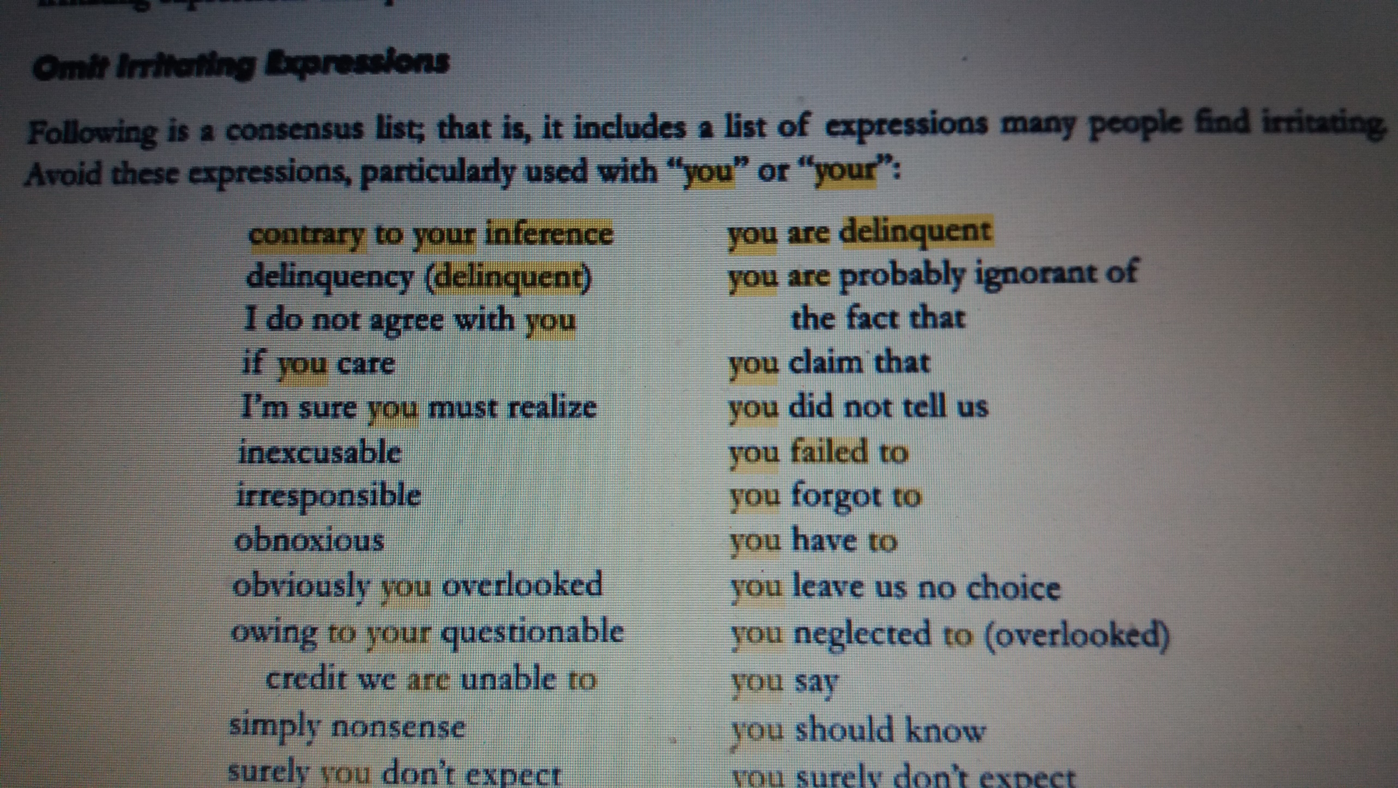

Slide 41

Choose Nondiscriminatory Expressions
 Another requirement for courtesy is the use of nondiscriminatory language that reflects equal treatment of people regardless of gender, race, ethnic origin, and physical features.
Questionable
More Desirable
Freshman
Entering students; first year student.
Workers; employees; work force personnel
Manpower

Slide 42

Exercise
Show courtesy by avoiding tactless & blunt language from the following message.
Your letter is not clear at all:
Obviously, if you would read your policy carefully you will be able to answer these questions yourself.
Apparently you already forgotten what I wrote you two weeks ago.

Slide 43

Exercise
Use gender friendly substitutes
Mankind
The best man for the job
Manmade
Manpower
Businessman
Sales man
Chairman

Slide 44

Exercise
 You guys should all be concerned about the issue.
Each manger has an assigned place – he should park his car….
Each customer will have change noted on his bill

Slide 45

CORRECTNESS
At the core of correctness is proper punctuation, and spelling.
grammar,
However a message may be perfect grammatically and mechanically but still insult or lose a customer. The correctness, as applied to business messages, also means the following three characteristics:
Use the right level of language.
Check accuracy of figures, facts, and words.
Maintain acceptable writing mechanics.

Slide 46

 Use the Right Level of Language
 Informal writing is more characteristics of business writing—even more so if that writing occurs in an E-mail message.
More Formal
Less Formal
Participate
Procure Endeavor
Join
Get
Try

Slide 47

 Check Accuracy of Figures, Facts, and Words
A good check of data is to have another person read and comment on the validity of the material.

Slide 48
An assignment will be uploaded on google classroom.

